Slide 1

Spartan Gallery
CSC 340 Group 6
Ross Dezarn Frankie KBriuh

Slide 2

What is the Spartan Gallery?
UNCG is well known for their Art School
Create a Gallery to help the students of UNCG create a portfolio and gain hands on experience in the art economy
Image Courtesy of USNews.com

Slide 3
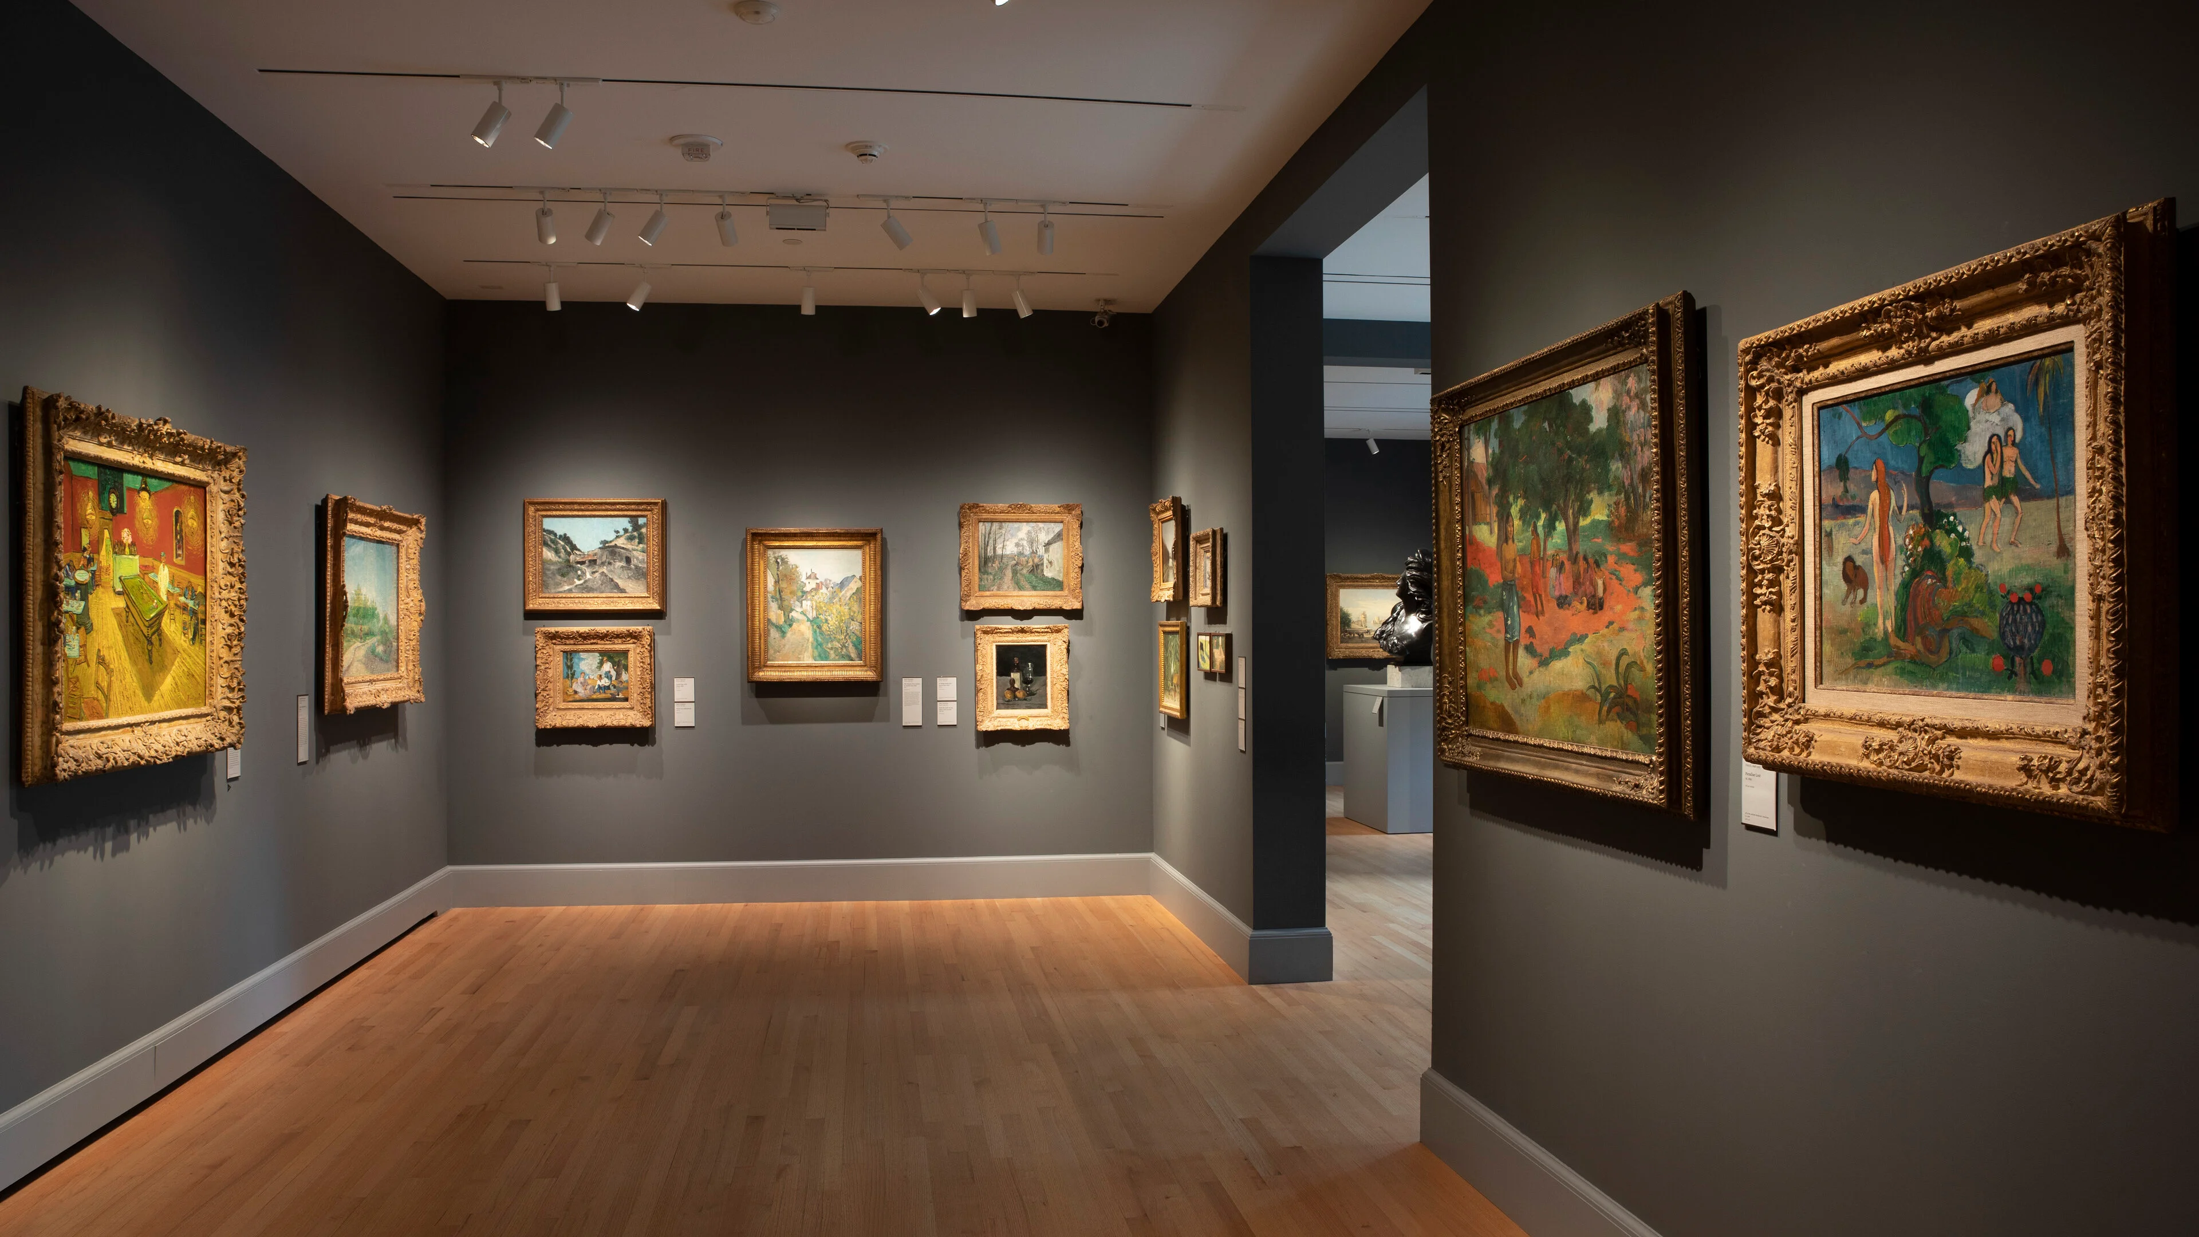
What Does the Gallery Do?
Store and display art pieces created by UNCG artists as well as give artists the ability to sell these pieces
Make it easier for average users to get to experience new forms of art that they would normally never see
Image Courtesy of Yale University Art Gallery

Slide 4
Who’s The Spartan Gallery For?
Users – The enjoyer’s of fine art
Artists – The creators and heart of the gallery
Admins – Overseers of the gallery

